Slide 1
AGM report
28 October 2015
Jenny Carr, SRF chairperson

Slide 2
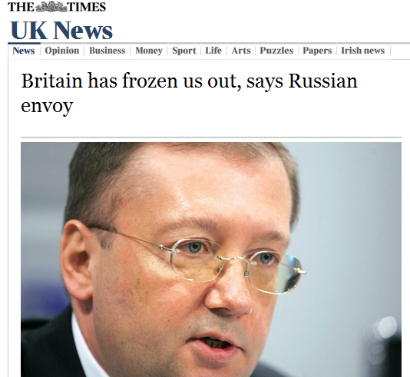
Political dialogue between Russia and Britain has gone and “the only sphere we have left is culture”, Russia’s ambassador to London has told The Times.
Alexander Yakovenko said that diplomatic relations had sunk to new lows over the Syria and Ukraine conflicts after having “bit by bit fallen into decline” in recent years
……
Times, 26 October 2015

Slide 3
What is the SRF and what is it trying to do?
Educational charity
Tries to promote understanding of all the countries of the FSU
Broad range of interests
“the respective ways of life, history, heritage and the cultural and commercial activities and voluntary services of the said countries and through the creation of educational contacts of all kinds between the peoples of these educational contacts of all kinds between the peoples of these countries” Constitution 3.2
Independent
Voluntary

Slide 4
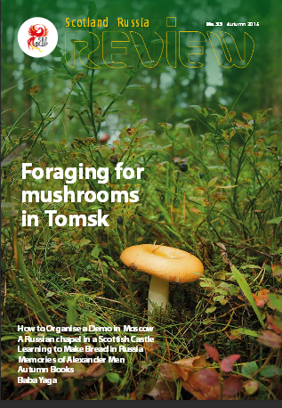
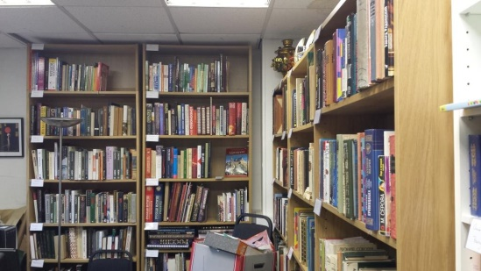
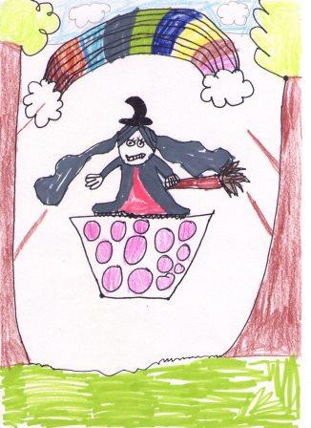
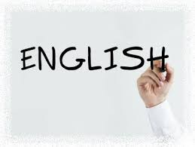
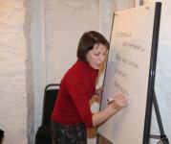
New projects

Slide 5
SRF events 2014-15
Sept 2014: Lermontov Exhibition and Reception, Scottish Parliament
Oct 2014: Business roundtable
Jan 2015: Roundtable on the Russian economy
March 2015: talk by Peter Pomerantsev on the Russian media
All year: monthly “Chai n Chat” meetings + summer outing
2015-6 so far: David MacFadyen on Russian Popular Music, Student party, Natalia Maeva poetry recital (2 Nov), Warwick Ball on Eurasian history (19 Nov).

Slide 6
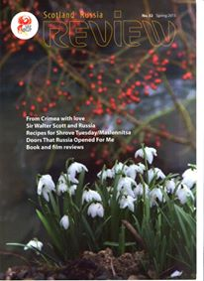
The Scotland Russia Review
Feb 2015
Sept 2015
500 copies are distributed, to members and others
The Review is also available online on www.scotlandrussiaforum.org/publications.html. The Feb 2015 issue was downloaded 1532 times Feb-Sept.

Slide 7
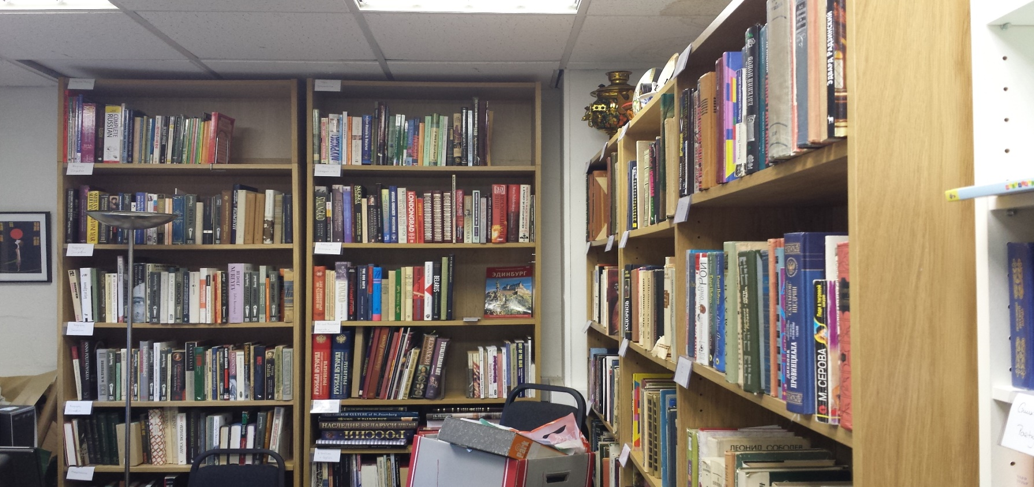
Library
Reorganised
Catalogue updated
Open for business

Slide 8
Schools project
Launched www.findoutaboutrussia.co.uk
Competition
Exhibition
School visits
Plans for 2015-16: more school visits, relaunch and improve the website, design other materials for schools

Slide 9
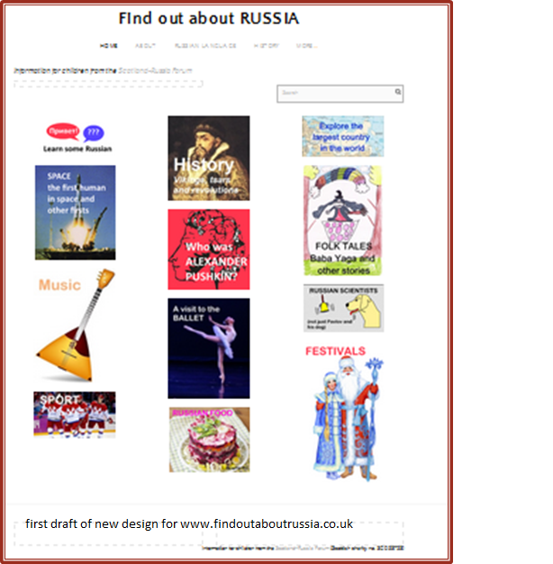
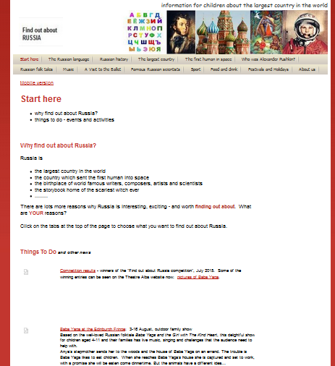
www.findoutaboutrussia.co.uk

Slide 10
Russian classes
2014-5:
classes continued , mainly intermediate and advanced, numbers overall were lower than in the past and many classes run in tutors’ homes
Student feedback good
2015-16:
launched the year with an Open Day and more publicity so now have a strong beginners’ class in addition to the other levels
Most classes this year will be in Summerhall

Slide 11
Information
Our main activity, mainly online
Monthly email bulletin
Website www.scotlandrussiaforum.org
Facebook “The Scotland-Russia Forum”
Twitter @ScotRussiaForum
(… and everything else we do)

Slide 12
Benchmarking – social networks
Related organisations | Facebook “likes” |  | Twitter followers
 | Dec 2014 | Oct 2015 | Dec 2014 | Oct 2015
Academia Rossica | 10286 | 10370 | 1798 | 1765
Rossotrudnichestvo UK | 3935 | 5085 | 14 | 3025
Pushkin House | 2682 | 3925 | 1696 | 2439
AUGB | 2523 | 3324 | 732 | 841
Russian Art & Culture | 1134 | 1863 | 2198 | 5796
SRF | 756 | 835 | 378 | 470
Dashkova Centre | 462 | 557 | 190 | 349
SCRSS | 171 | 293 | 0 | 0
Westminster Russia Forum | 191 | 248 | 925 | 1043
RCS Haven | 114 | 138 | 23 | 34
GB-Russia Soc | 29 | 113 | 10 | 12

Slide 13
Websites and e-bulletin
www.findoutaboutrussia.co.uk:
average 2000 visits March-Sept 2015
E-bulletin: 1145 addressees, Oct 2015

Slide 14
English language assistants
We recruit English language assistants for a number of Russian universities.
Work closely with Scottish university Russian depts and last year had more applicants than ever before.
Placements are few most years but closer relations with the Russian universities should improve the situation.

Slide 15
Plans for 2016
New constitution
Redesign of both websites
New Russian writing – work with Glas
Talks and exhibition(s)?
Stand at the Language Show in Glasgow
Visit more schools

Slide 16
www.scotlandrussiaforum.org/newwriting.html

Slide 17
New projects

Slide 18
Thanks to:
Officers and committee
Members
Supporters, moral and financial
SRF Review team
Чай н Чат organisers
Language tutors
Collaborators
Volunteers
Russian and Ukrainian Consulates
And others!

